Slide 1
Food and Water Security
Overview
Gordon Young
President International Association of Hydrological Sciences
GEOSS S+T Stakeholder Workshop
Breakout Session B4
Bonn, 30 August 2012

Slide 2
Aims of Session B4
To set water security within the broader framework of global security issues
To define the elements of water security
To focus on food security issues (Bhaduri)
To elaborate on the relevance of global earth sciences (Lawford and Liebe)
To produce recommendations on how best to incorporate earth observation monitoring systems into the management of water and food security

Slide 3
Placing water security within the much broader context: the many elements of global security in a world of change and uncertainty
Global population explosion
Geo-political changes and re-alignments
Unrest / warfare in many countries and regions
Global terrorism
Financial crises
Health risks and vulnerabilities
Climate change
Sun spot activity, volcanoes, earthquakes

Slide 4
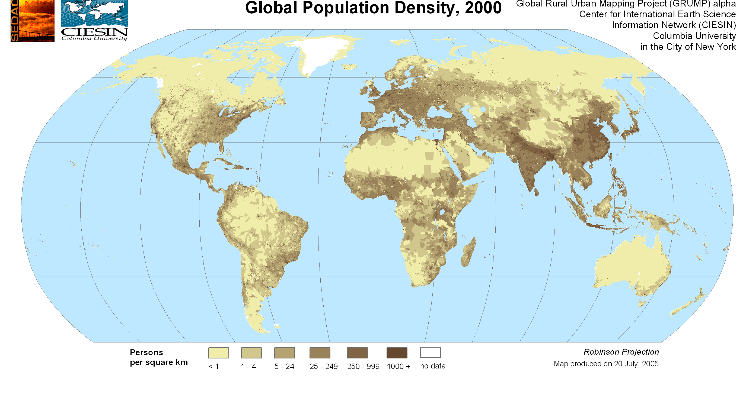
Population changes
Rapid growth versus significant declines
Movements: rural to urban; between countries and regions

Slide 5
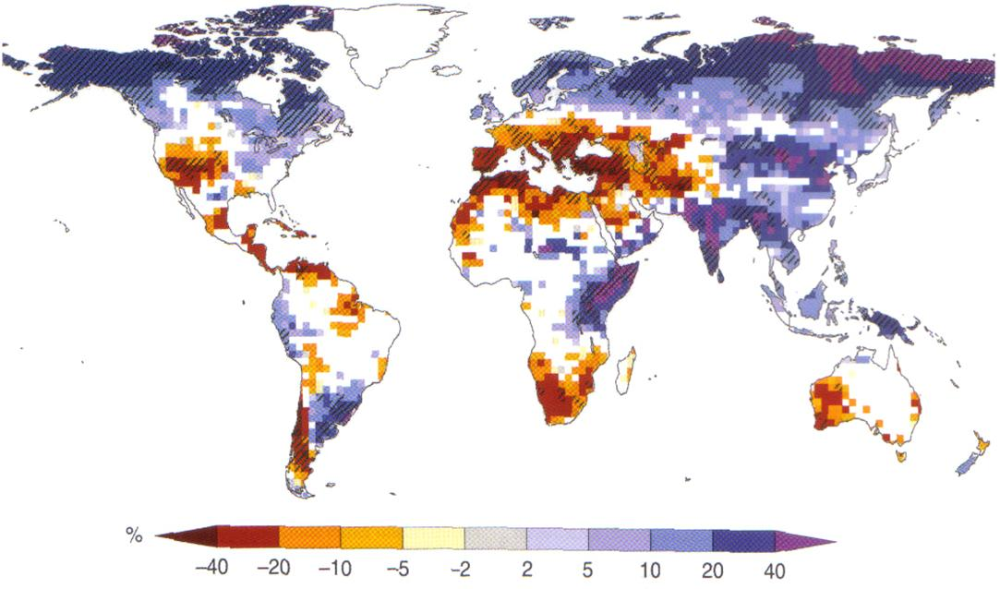
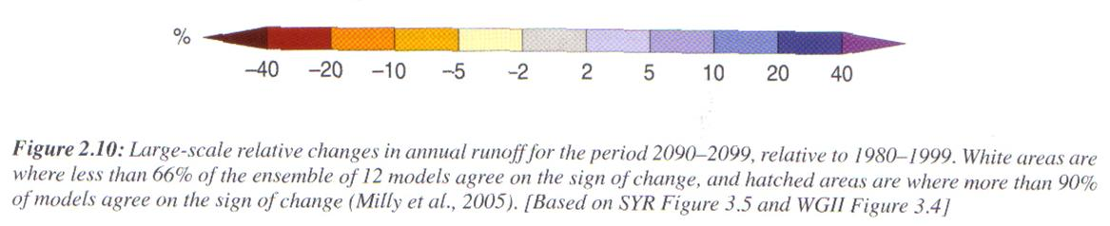
Global Precipitation changes 1990 - 2090

Slide 6
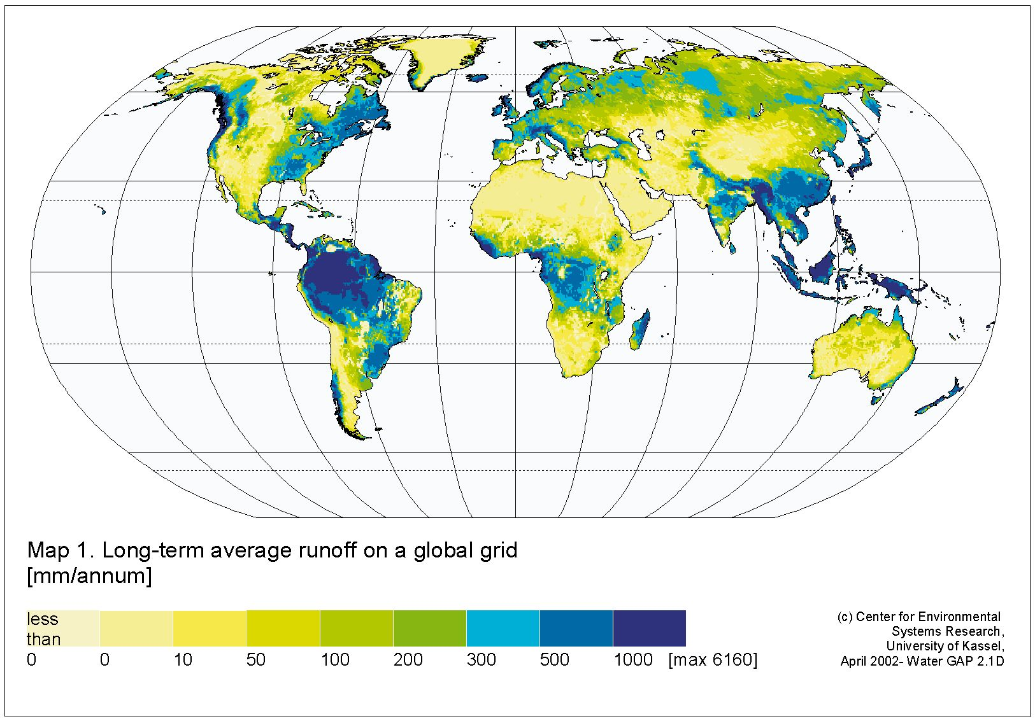

Slide 7
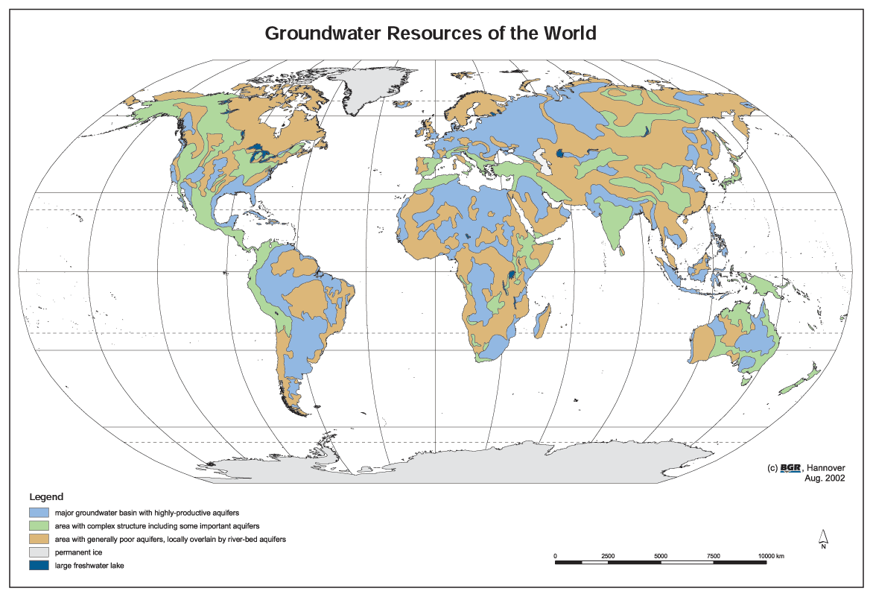

Slide 8
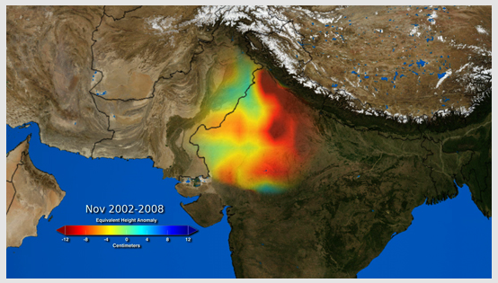
Grace Satellite estimation of groundwater depletion in NW India
109 cubic km loss in 6 year period

Slide 9
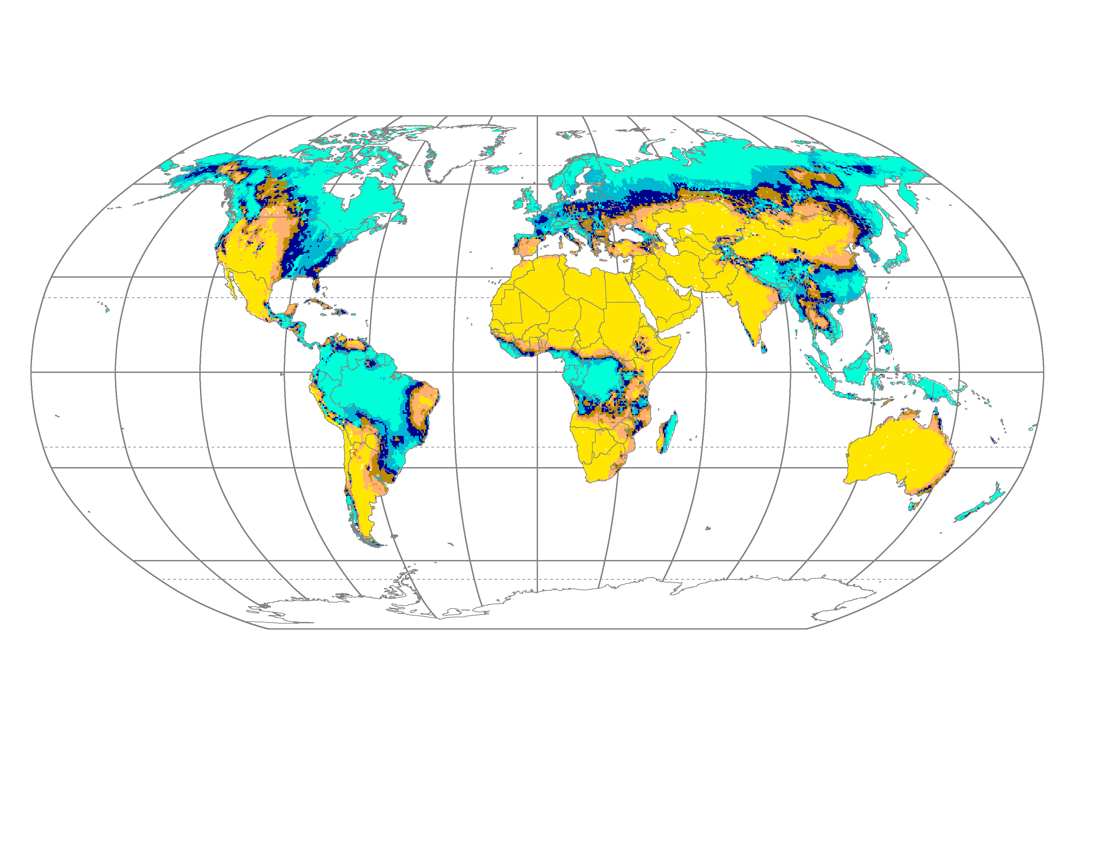
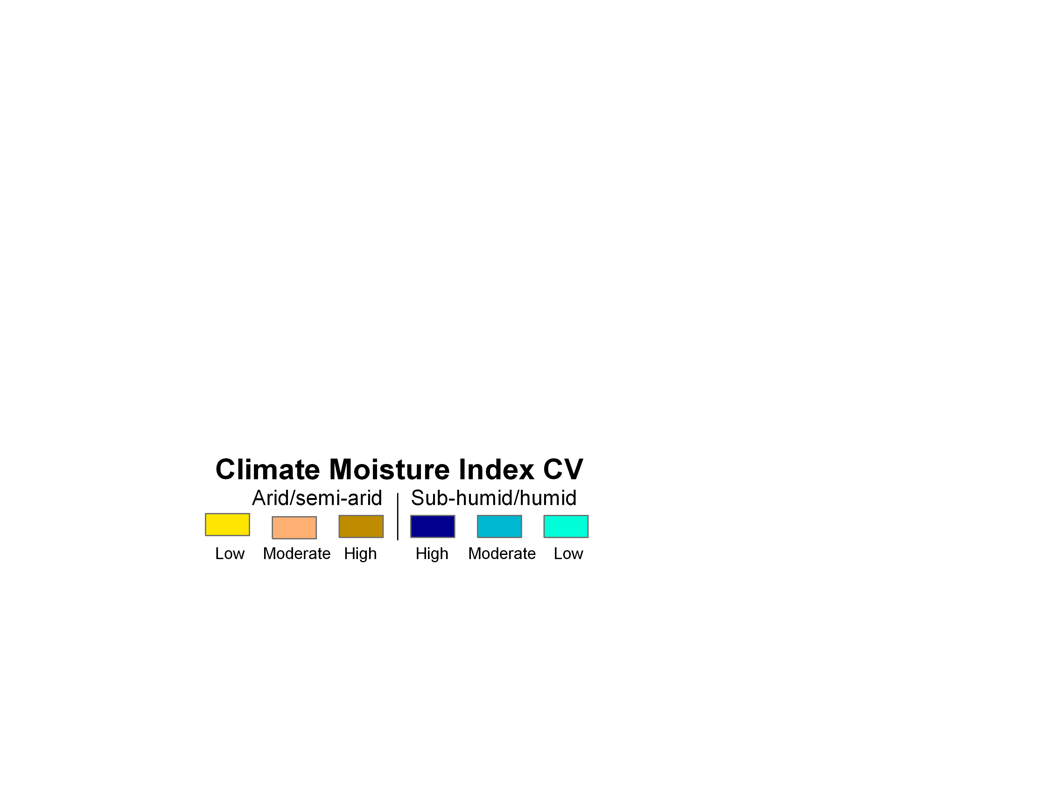
The Climate Moisture Index, representing climatically-induced water variability

Slide 10
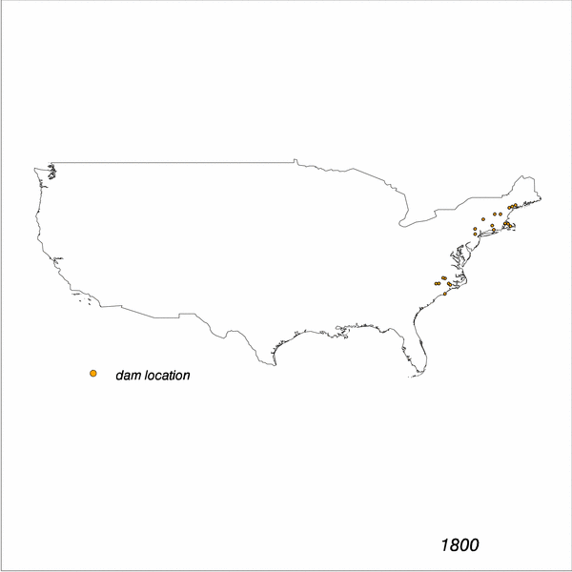
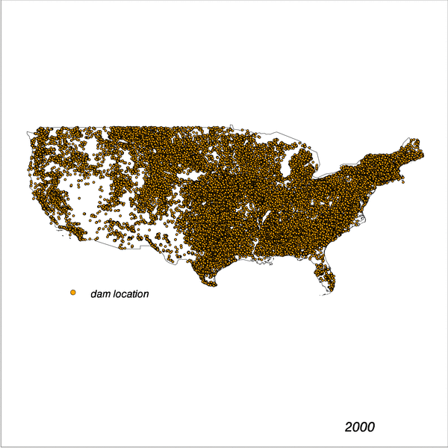
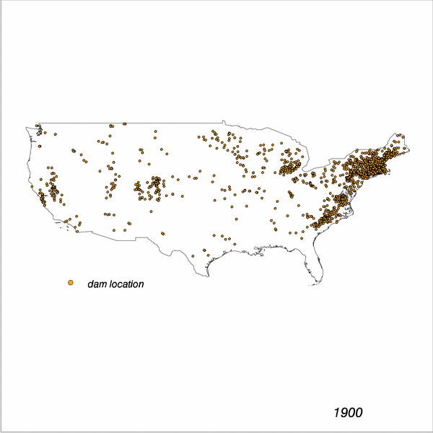
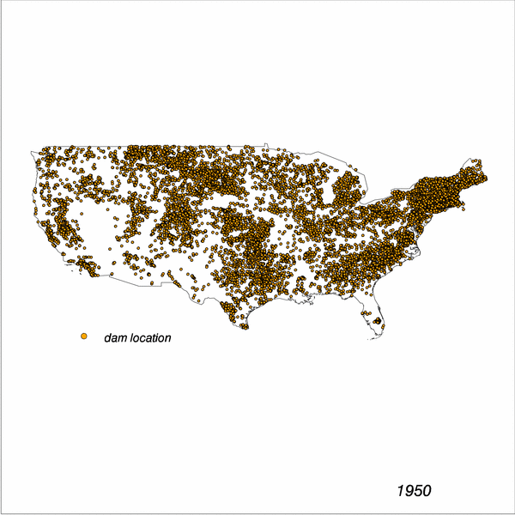
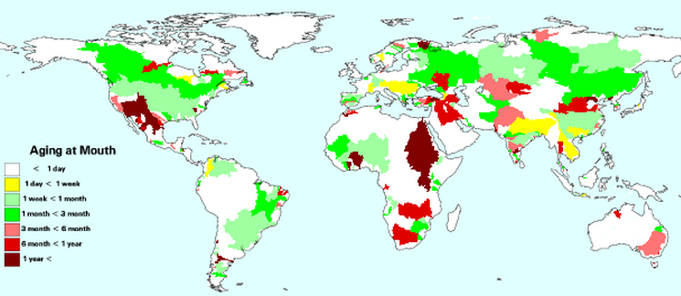
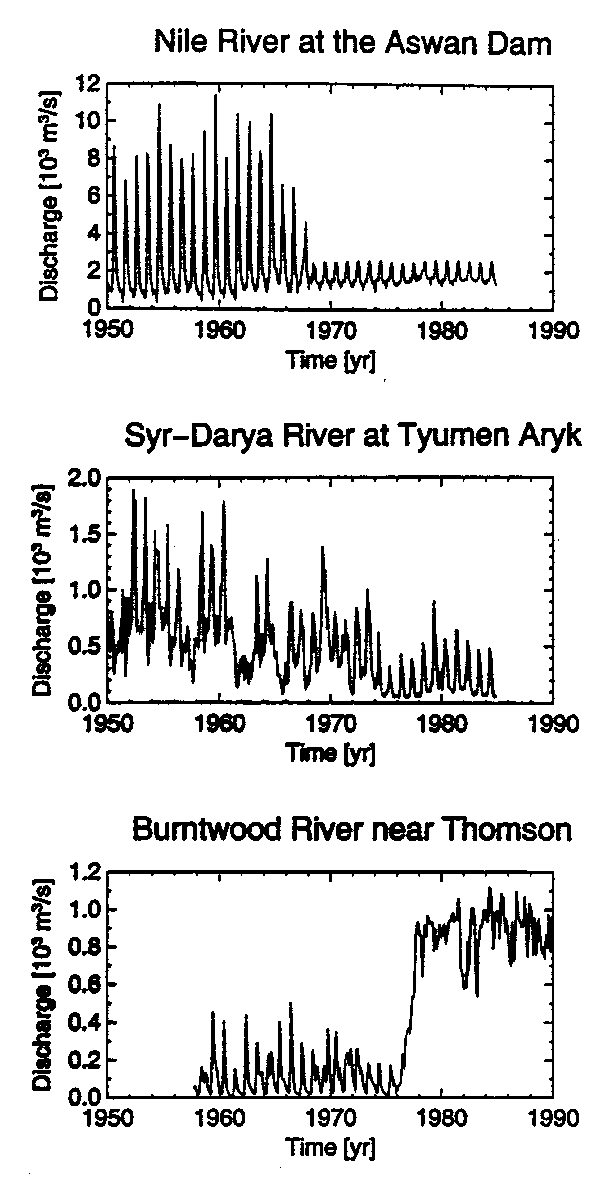


History of US Dam & Reservoir Construction
1800
1900
1950
2000
2000
• 700% increase in water held by river systems
• Several years of residence time change in many basins
Tripling of river runoff travel times globally (from 20 up to 60 days)
Substantial impact on aquatic biodiversity
Interception of 30% of continental TSS flux
Stored Runoff
< 2% annual flow
2
10
25
50
100
>100
From: Vörösmarty et al. 2004, Eos-AGU Trans.

Slide 11
Elements of water security
  Diverse uses of water
  Human well-being – health, food security
  Economic development (energy, industry)
  Social development
  Water to sustain ecosystems
  Water as a threat
    Floods
    Droughts
    Pollution

Slide 12
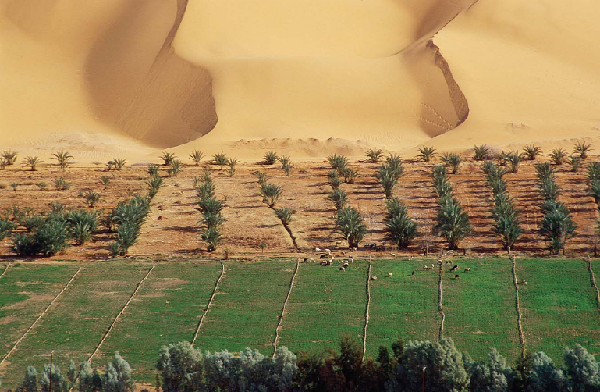
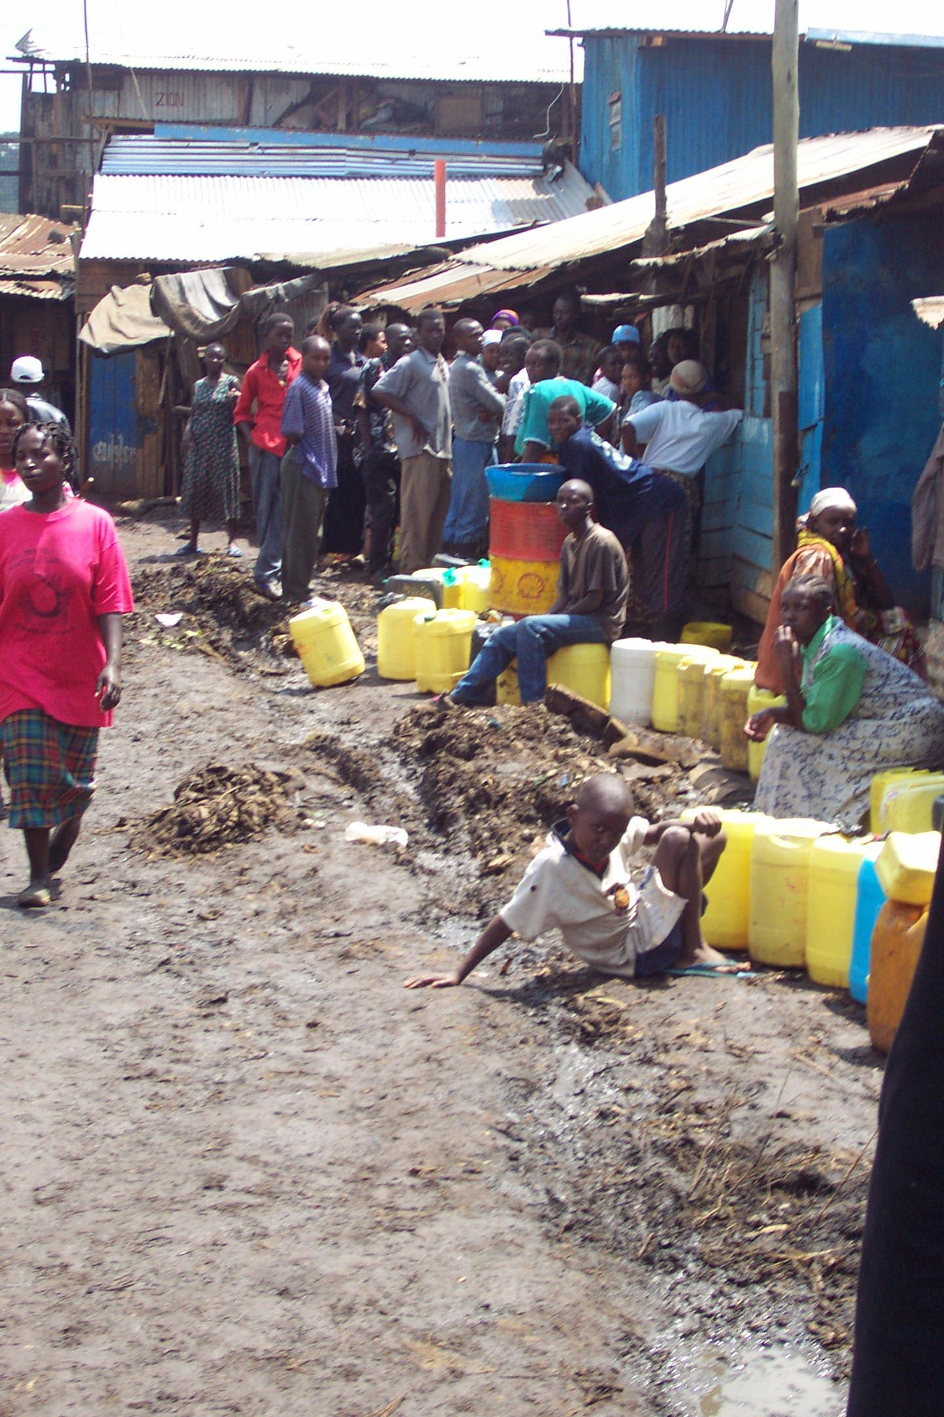
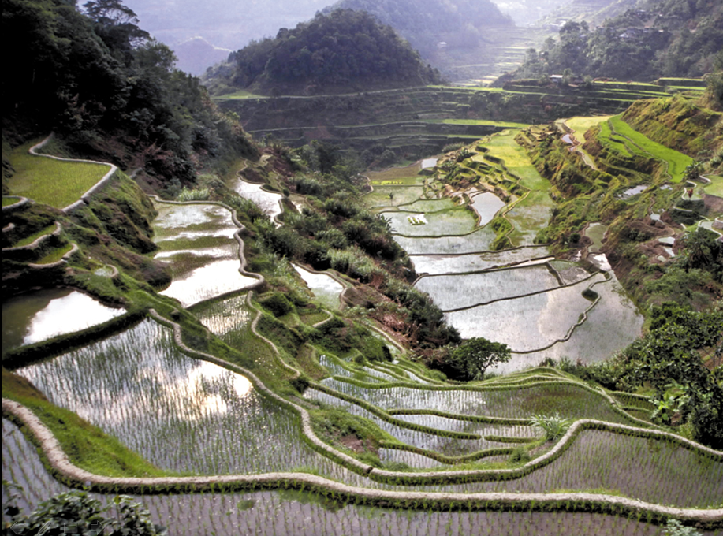
Basic Human Well-being – water for health and food security

Slide 13


Slide 14
The Importance of Personal Hygiene

Slide 15
Social development
- The need for education
- The effects of lack of drinking water and sanitation on education

Slide 16
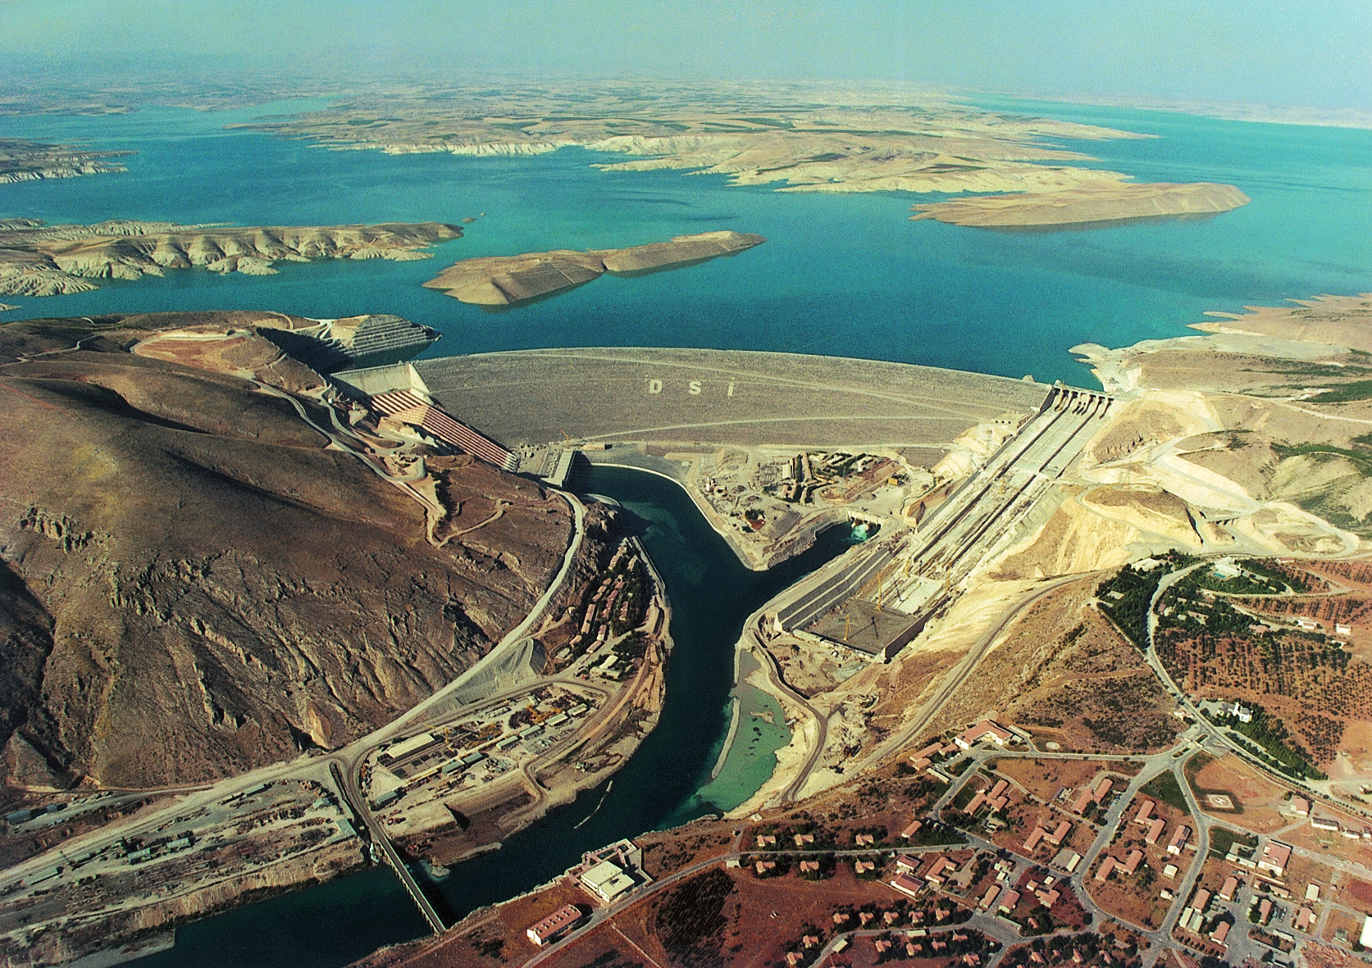
Ataturk dam, Euphrates River, Turkey

Slide 17
The Energy Linkage
2108
2,000
1,800
United States consumption – 12000kWh/capita/yr
1,600
1,400
1,200
500 kWh/capita/year minimum consumption
Elec. consumption (kWh/yr)/Capita
900
1,000
for reasonable quality of life
800
581
600
430
400
184
204
85
126
114
200
21
55
38
29
0
Nigeria
Ethiopia
Kenya
Tanzania
Uganda
Ghana
Senegal
Algeria
Egypt
Cameroon
Morocco
Burkina Faso
World Average
Energy use per person in Africa kWh/cap/year
Notes:
Again on The “why” – the need, indeed, the development imperative – for moving beyond the crossroads is well visible on this slide.

Slide 18
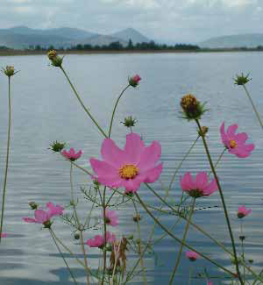
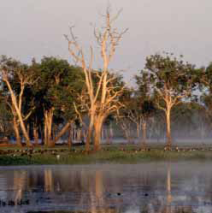
Water for natural ecosystems

Slide 19
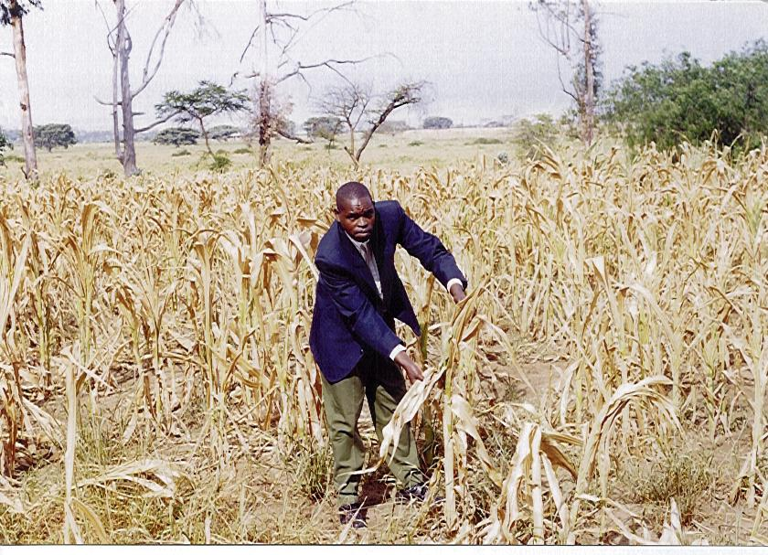
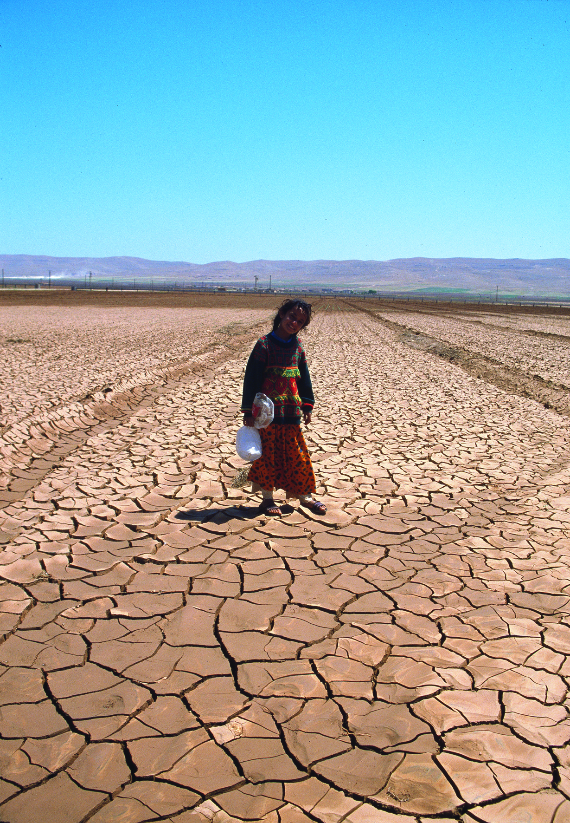
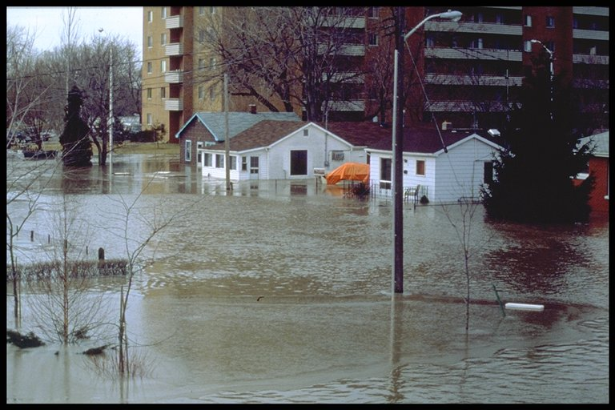
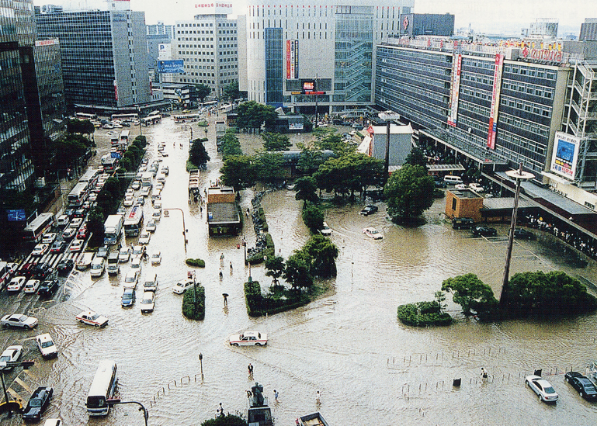
Extreme hydrological variability: floods and droughts
FLOODS
AND
DROUGHTS

Slide 20
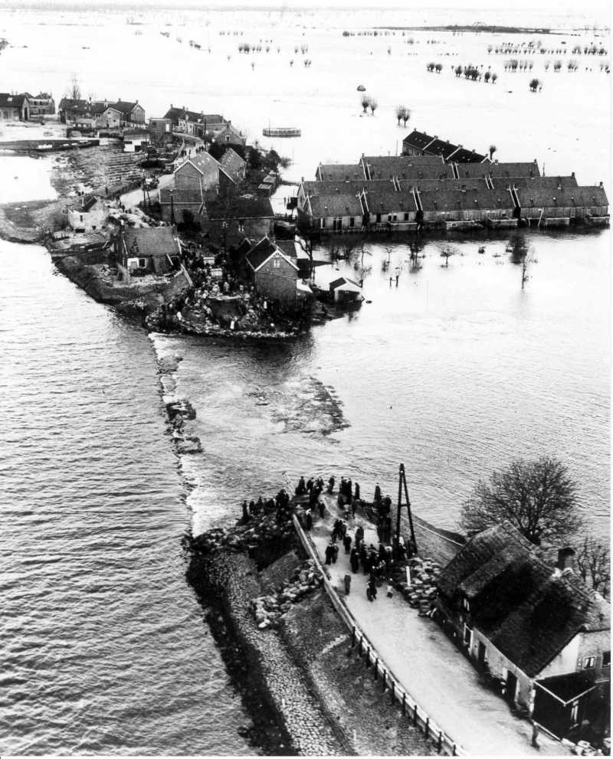
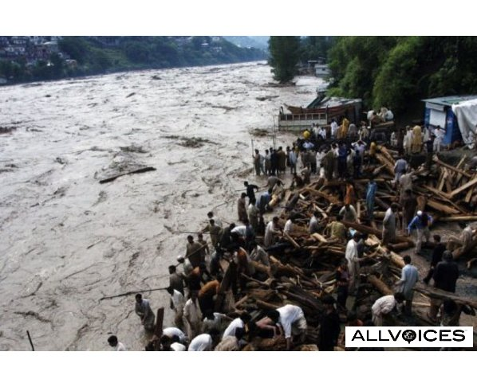
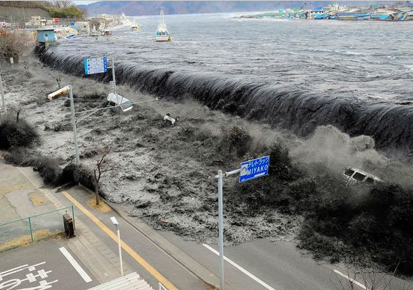
Water as a threat:
Floods from the land
Storm surges, tsunamis from oceans

Slide 21
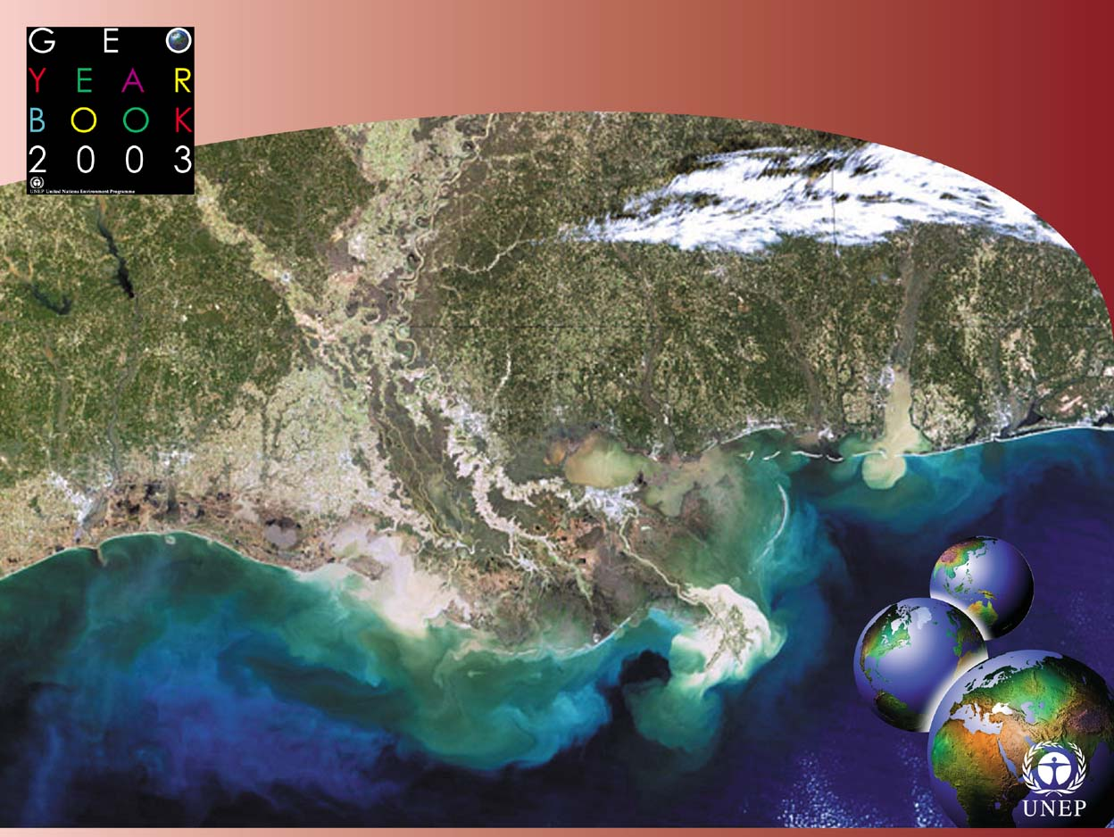
OXYGEN STARVED ZONES

Slide 22
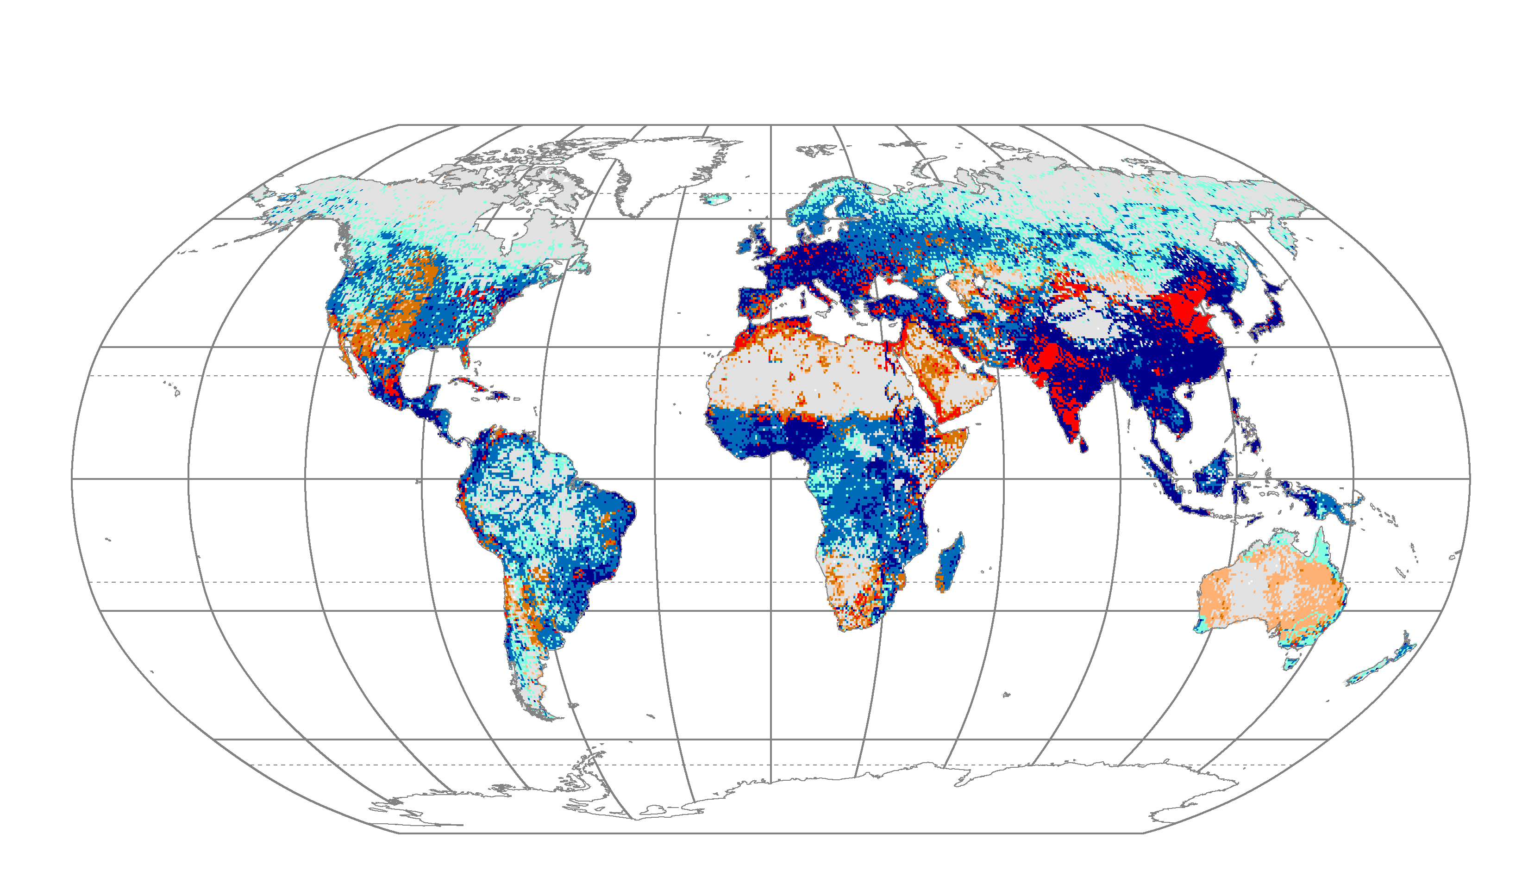
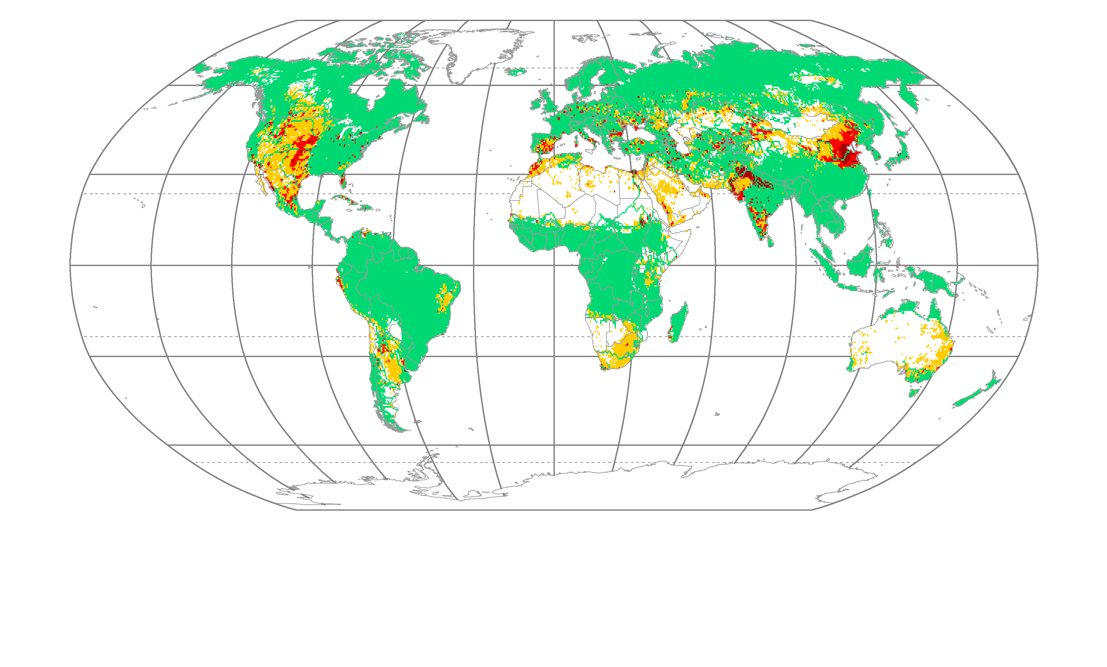
Regions of stress
Non-sustainable use

Slide 23
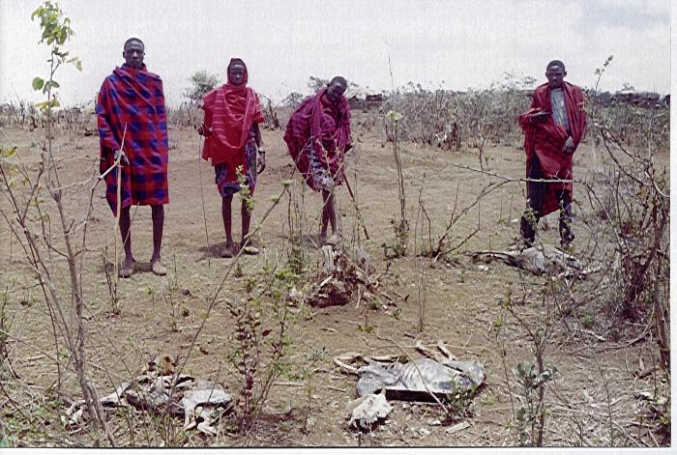
Thank You
Regions of stress
Non-sustainable use

